Slide 1

Ensemble Deep Learning for Enhanced Crop and Weed Classification in Agriculture
by Varnika Milind Mulay (MST03-0060)

Slide 2

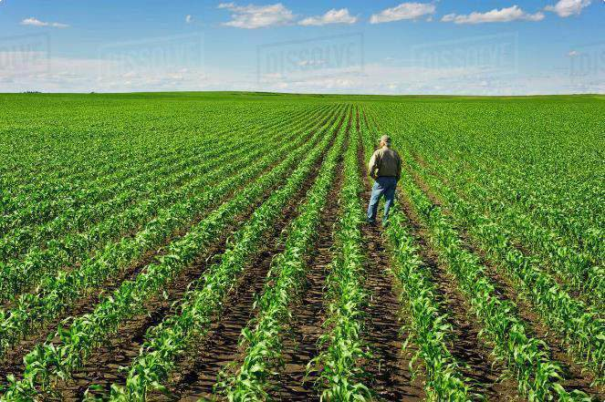
Importance of Accurate Classification
1
Yield Optimization
Precise identification of crops and weeds enables targeted application of herbicides and fertilizers,
fertilizers, maximizing crop yield and reducing waste.
2
Disease Detection
Early detection of plant diseases through image classification aids in timely intervention, preventing widespread damage and ensuring healthy crop growth.
3
Precision Agriculture
Automated classification systems empower farmers to make data-driven decisions, optimizing resource allocation and improving overall farm management.
4
Environmental Sustainability
By reducing the use of broad-spectrum herbicides, classification techniques contribute to environmentally friendly practices and minimize ecological impacts.

Slide 3
Overview of Deep Learning Techniques
Deep Learning for Image Classification
Convolutional Neural Networks (CNNs)
Advantages of Deep Learning
Deep learning offers high accuracy, adaptability to diverse image datasets, and automation potential, making it suitable for real-world applications.
Deep learning algorithms, particularly CNNs, excel in image recognition tasks due to their ability to learn complex patterns and features from large datasets.
CNNs are designed to process images by extracting features through convolutional layers, followed by pooling layers for dimensionality reduction and fully connected layers for classification.

Slide 4

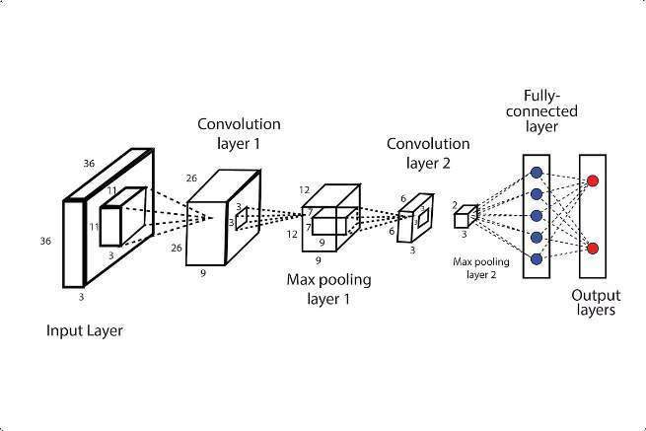
Convolutional Neural Networks (CNNs)
Convolutional Layers
These layers apply filters to the input image, extracting features like edges, textures, and patterns.
1
2
Pooling Layers
Pooling layers reduce the dimensionality of feature maps, making the model
more robust to variations in image size and position.
Fully Connected Layers
Fully connected layers classify the extracted features by combining them into a probability distribution over different classes.
3

Slide 5
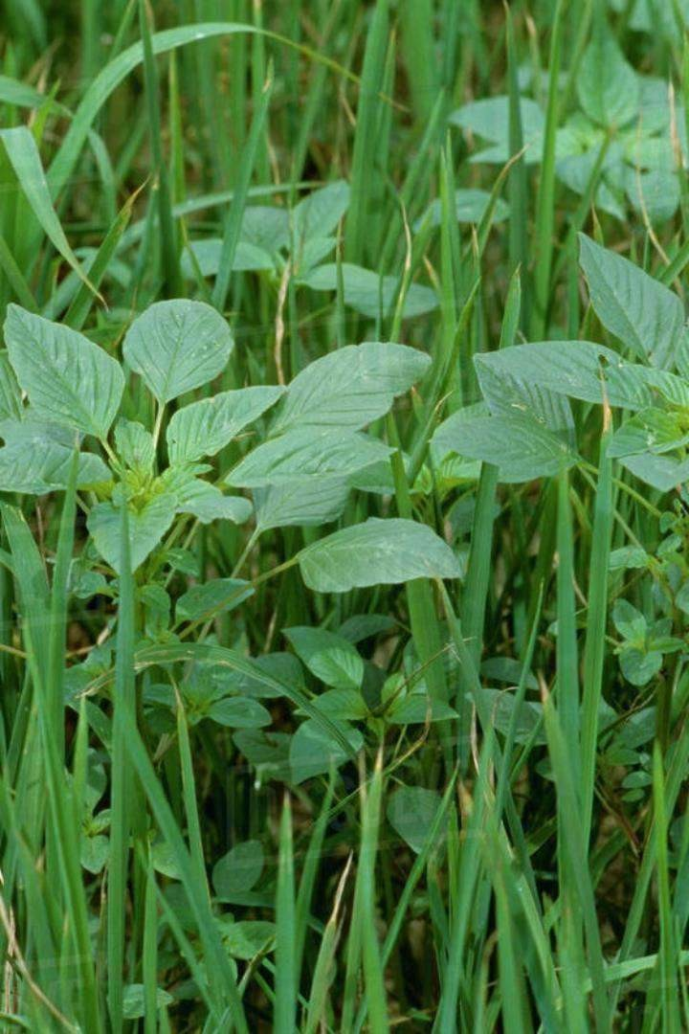
ResNet50: Powering Image Classification
ResNet50, a state-of-the-art convolutional neural network, is the backbone of our deep learning-powered crop and weed classification system.
With 50 layers, this architecture delivers unparalleled accuracy, efficiency, and scalability for real-world agricultural applications.
ResNet50's advanced techniques, like residual connections, enable it to learn rich visual features from large datasets, optimizing yield, detecting diseases, and empowering precision farming. Its versatility makes it a cornerstone of our innovative deep learning solutions.

Slide 6

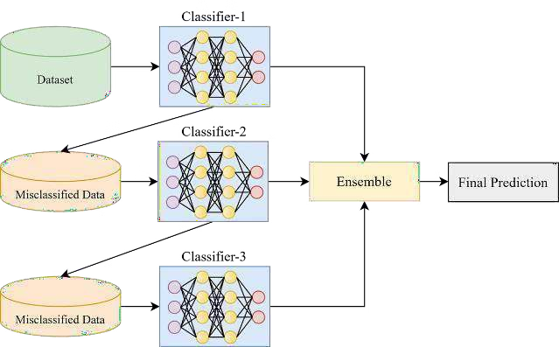
Ensemble Models for Crop and Weed Classification
To improve accuracy, we developed an ensemble combining a CNN and ResNet50. By averaging outputs, the ensemble leverages the strengths of each approach for enhanced performance.
The ensemble preprocesses inputs the same, then passes them through both models and averages probabilities for the final classification. This outperforms the individual models, increasing accuracy and robustness for crop and weed identification.
Evaluation demonstrates the ensemble's significant improvements over individual models, providing farmers and agronomists a reliable tool to support sustainable agriculture.

Slide 7

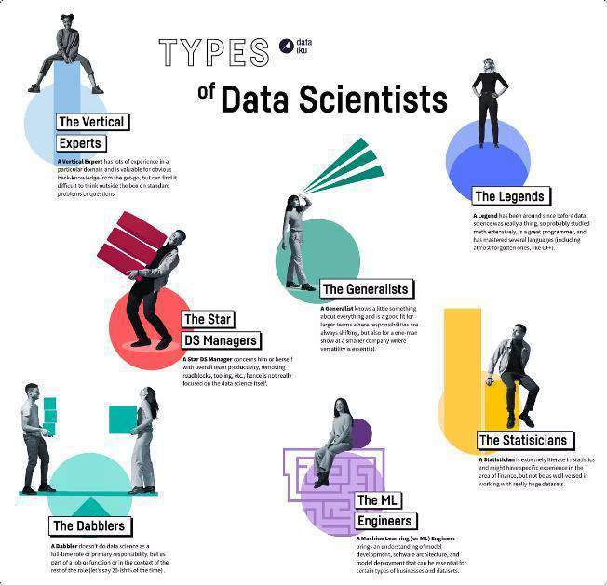

Dataset Preparation and Preprocessing
Data Collection
Acquire a diverse dataset of labeled images, including various crop and weed types, growth stages, and lighting conditions.
Data Augmentation
Increase the size and diversity of the dataset by applying transformations like rotation, scaling, and flipping.
Data Normalization
Scale the pixel values to a common range, improving model training efficiency and preventing bias.

Slide 8
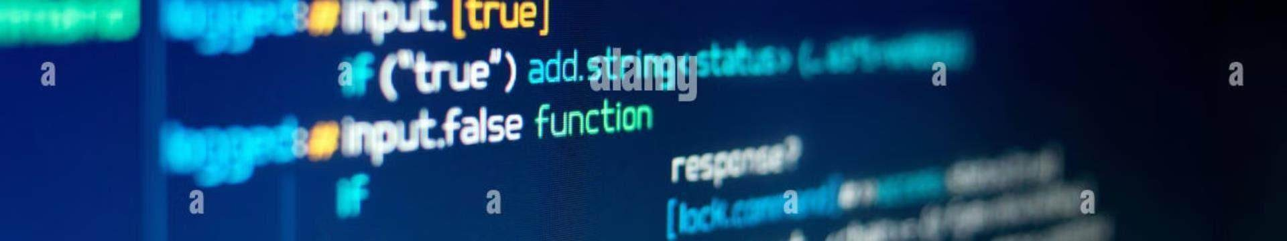



Training and Evaluation of Deep Learning Models
Training
Train the deep learning model on the prepared dataset, optimizing its parameters to minimize errors.
Evaluation
Evaluate the trained model's performance using metrics like accuracy, precision, recall, and F1- score.
Fine-tuning
Adjust hyperparameters and architecture based on evaluation results to improve model performance and generalization.

Slide 9

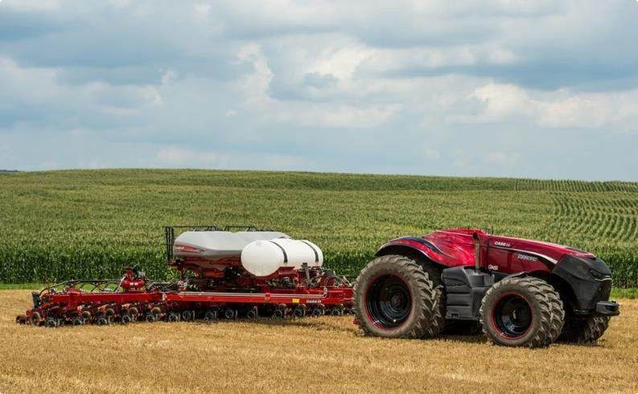
Deployment and Real-World Application
Agricultural Robotics
Integrate the classification system into agricultural robots
for automated weed control and crop monitoring.
Mobile Applications
Deploy the model on mobile devices to provide on-the-go
crop and weed identification for farmers.

Slide 10

Conclusion and Future Research Directions
Deep learning has emerged as a powerful tool for crop and weed classification, enabling precision agriculture and sustainable farming practices. Future research focuses on improving accuracy, robustness, and adaptability to diverse agricultural environments.

